Slide 1
SIMULATION OPTIMIZATION: NEW ADVANCES FOR REAL WORLD OPTIMIZATION
Fred Glover
Marco Better

Slide 2
Outline
What is simulation optimization?
Why is it important?
Classical approaches
Metaheuristic approaches
Applications
Conclusions
Slide <number>

Slide 3


What is Simulation Optimization?
The optimization of simulation models deals with the situation in which the analyst would like to find which of possibly many sets of model specifications (i.e., input parameters and/or structural assumptions) leads to optimal performance
Input
parameters
Measure of
performance
Slide <number>

Slide 4
Simulation Optimization
Why is it required?
Complex models contain many variables and constraints as well as uncertainty
What-if simulation analysis unlikely to result in an optimal answer due to large number of possible solutions
Inability of pure optimization to model complexities, uncertainties and dynamics of scenarios.
Simulation-Optimization removes these inabilities by combining both approaches.
Slide <number>

Slide 5
Simulation-Optimization
Why is it required?
A total solution requires both capabilities.
Two-Step Solution
  Simulation
  Optimization
Both are necessary, neither is sufficient.
Slide <number>

Slide 6
Simulation Optimization
Benefits in Dealing with Uncertainty
Simulation enables understanding/modeling and communications of uncertainty.
Optimization enables management of uncertainty.
Slide <number>

Slide 7
Classical Approaches
Stochastic approximation
  Gradient-based approaches
Sequential response surface methodology
Random search
Sample path optimization
  Also known as stochastic counterpart
Slide <number>

Slide 8
References
April, J., F. Glover, J. Kelly and M. Laguna (2003) “Practical Introduction to Simulation Optimization”, Proceedings of the 2003 Winter Simulation Conference, S. Chick, P. J. Sánchez, D. Ferrin, and D. J. Morrice, eds.
Fu, M. (2001) “Simulation Optimization,” Proceedings of the 2001 Winter Simulation Conference, B. A. Peters, J. S. Smith, D. J. Medeiros, and M. W. Rohrer, eds., pp. 53-61.
Slide <number>

Slide 9
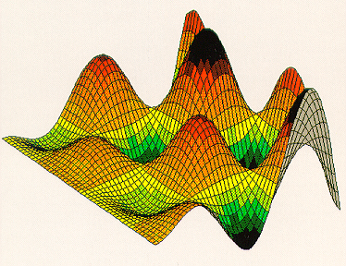
Optimization on a Metamodel
Slide <number>

Slide 10
Model Components
Simulation/Complex Models
Integer Variables
  e.g., Only select one option within a group
Constraints
  e.g., Budget
Multiple Objectives - “Requirements”
  e.g., Maximize Objective while keeping 5th percentile of a performance metric above some goal (risk control).
Slide <number>

Slide 11

Simulation Optimization
Simulator /
Complex
System
Inputs
Outputs
OptQuest
Slide <number>

Slide 12

Mathematical Model
Searching for X such that:
Minimize or Maximize OBJECTIVE =E[f(X)]
X ε Subset of discrete, continuous, or mixed space.
X satisfies linear inequalities or equalities.
E[g(X)] may be forced to obey simple bounds (Requirements)
(includes nonlinear constraints)
f(X) and g(X) are complex mappings that are accomplished
through simulation or complex system evaluation.

Slide 13
The Optimization Challenge
Function to be Optimized
  Highly Nonlinear
  Nondifferentiable
  Discrete or Continuous or Mixed
Function Evaluations
  Complex
  Extremely Computer Intensive
  One second to One Day per Evaluation!

Slide 14
OptQuest®
Scatter Search
Advanced Tabu Search
Linear Programming
Integer Programming
Neural Networks
Linear Regression
Research funded by National Science Foundation and Office of Naval Research.
Slide <number>

Slide 15
Example: Algorithm Tuning
Typical Meta-Heuristic Development Cycle
1. Define Problem (10%)
2. Create Algorithm (10%)
3. Fine Tune Algorithm (75%)
4. Implement Final Design (5%)
Slide <number>

Slide 16

Algorithm Tuning with OptQuest
OptQuest
Paths per Call
Frequency Penalty
Short-Term Memory
Medium-Term Memory
Long-Term Memory
Tenure
Tabu Search
for Bandwidth
Packing
Algorithm*
Profit
*Laguna & Glover, Management Science, 1993.

Slide 17
Computational Testing
20 Problems from Laguna & Glover (1993)
  10 problems without link costs (Set A)
  10 problems with link costs (Set B)
1. Tune for Each Problem
2. Tune for Each Set of Problems
Slide <number>

Slide 18
Tuning per Problem
Profits (Without Link Costs: Set A)
Laguna & Glover (1993) OptQuest
7,540 7,754 +
2,100 2,100
13,550 13,710 +
2,955 2,955
2,345 2,395 +
9,010 9,010
11,000 11,160 +
12,810 12,810
5,780 5,780
970 970
Slide <number>

Slide 19
Tuning per Problem
Profits (With Link Costs: Set B)
Laguna & Glover (1993) OptQuest
6,076 6,091 +
1,921 1,937 +
6,393 6,470 +
2,784 2,786 +
2,288 2,330 +
8,039 8,094 +
9,539 9,591 +
11,349 11,371 +
4,555 4,555
656 661 +
Slide <number>

Slide 20

Comments
Inputs
Algorithm
Outputs
Fine-Tuning Optimization
  Difficult Problem that we spend too much time on!
  Can be effectively addressed through a blend of techniques from the area of metaheuristics.
  Allow us to spend more time on algorithm design and development.
Fine-Tuning for specific data can customize an algorithm for the environment in which it resides making it more effective.

Slide 21
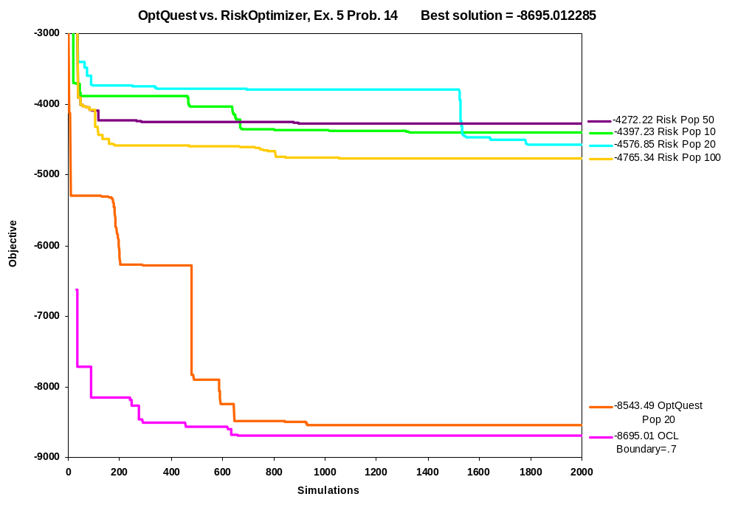
Efficiency is Critical!

Slide 22
Sample Path Optimization
It attempts to exploit the machinery available for determinist optimization problems on continuous variables
A sample of size n is drawn and the objective function is evaluated using this sample making the problem deterministic
The size of the sample to obtain a good estimate of the objective function value is still an open question
Slide <number>

Slide 23
Metaheuristic Approaches
Based on neighborhood search
  Tabu search
  Simulated annealing
Based on combining solutions in a population
  Genetic algorithms
  Scatter search
Slide <number>

Slide 24
Modular Design
Metaheuristic
Optimizer
Input parameters
Objective function value
Simulation
Model
Slide <number>

Slide 25
Simulated Annealing
Simulated Annealing is an extension of Random Search that allows nonimproving moves with a certain probability
The probability of accepting a nonimproving move decreases with the temperature
The temperature is controlled by the cooling schedule
Slide <number>

Slide 26
Tabu Search
Uses a systematic neighborhood search to choose the best neighbor
  Size of the neighborhood is controlled by candidate list strategies
  The selection of the best neighbor is constrained by tabu functions
The best move may be nonimproving
Memory functions (short and long term) are updated after every move
Slide <number>

Slide 27
Tabu Search:
Implementation Issues
Feasible point
Infeasible point
Current point
Optimal point
Nontabu move
Tabu move
Slide <number>

Slide 28
Genetic Algorithms
The search consists of evolving a population of solutions
Typically, the initial population is constructed randomly
New solutions (offspring) are generated by combining two solutions (parents) in the existing population
Slide <number>

Slide 29
Genetic Algorithms:
Implementation Issues
The evaluation of the initial population is computationally expensive
Randomness guards GA implementations against performing extremely bad in any given problem, but also makes the search less aggressive
Classical GA implementations (for optimization of deterministic functions) call the objective function evaluator millions of times
Slide <number>

Slide 30
Scatter Search
Combines solutions in a small reference set to create new trial solutions
Uses generalized combination methods with controlled randomization
The selection process is deterministic
The updating of the reference set (aka the “evolution process”) is also deterministic and attempts to create a balance between solution quality and diversity
Slide <number>

Slide 31
Basic Scatter Search
P
Diversification Generation
Method
Repeat until |P| = PSize
Improvement
Method
Improvement
Method
Reference Set
Update Method
Solution Combination
Method
Subset Generation
Method
RefSet
Stop if no more
new solutions
Slide <number>

Slide 32
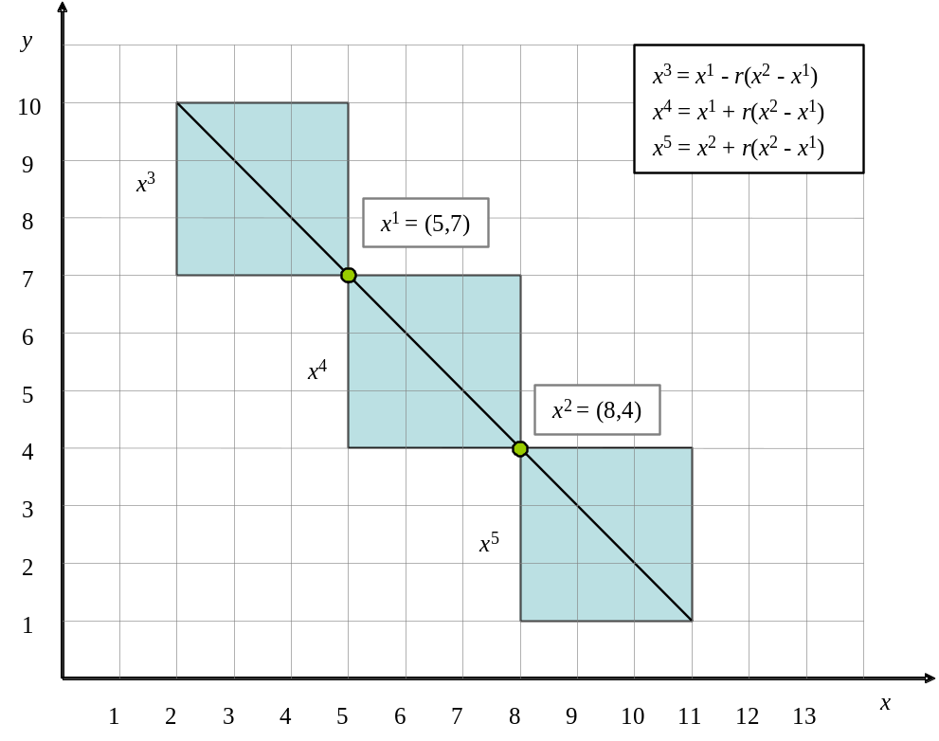
Linear Combination Method
Slide <number>

Slide 33
Scatter Search:
Implementation Issues
Construction of the initial reference set should be done without evaluating the population
Designing a strategy to control the number of solutions generated from each combination
Static update is easier to parallelize but dynamic update is more aggressive
Slide <number>

Slide 34
Issues Related to Metaheuristics for Simulation Optimization
Aggressiveness of the search
  Balance between diversification and intensification
Solution representation
  Combination methods
Use of metamodels
Constraint handling
Length of simulation and selection of best solution
Slide <number>

Slide 35
Aggressiveness of the Search
Less aggressive but diversified
Objective function value
Aggressive and less diversified
Calls to the simulator
Slide <number>

Slide 36
Solution Representation
Continuous variables
Discrete variables
  Resources (e.g., number of machines, number of technicians, etc.)
  Design choices (e.g., brand, category, etc.)
Binary variables
  Special case of discrete variables
Permutation variables
  Imply so-called all-different constraints
Slide <number>

Slide 37


Use of Meta-models
Neural networks
Regression
Metaheuristic
Optimizer
x
Metamodel
f(x)
Simulation
Model
No
large d?
Yes
Discard x
Slide <number>

Slide 38
Handling Constraints
Constraint
Mapping
F(x*)
Penalty
Function
x
x*
Simulator
P(x*)
G(x*)
x = input parameters (possibly infeasible)
x* = mapped input parameters (constraint feasible)
F(x*) = objective function value
G(x*) = value of other output variables used in constraints
P(x*) = penalized objective function value
Slide <number>

Slide 39
Length of Simulation
Simulation runs during the optimization process are typically shorter than those of confirmation runs
A run can be terminated early if it can be predicted that the outcome will not improve upon the current best solution
  This can be done with statistical analysis tools such as confidence intervals and hypothesis testing
Slide <number>

Slide 40
OptQuest®
Simulation Optimization Applications:
the best configuration of machines for production scheduling
the best integration of manufacturing, inventory and distribution
the best layouts, links and capacities for network design
the best investment portfolio for financial planning
the best utilization of employees for workforce planning
the best location of facilities for commercial distribution
the best operating schedule for electrical power planning
the best assignment of medical personnel in hospital administration
the best setting of tolerances in manufacturing design
the best set of treatment policies in waste management
Slide <number>

Slide 41
Selection of the Best Solution
Using a sample-path approach turns the evaluation into a deterministic process
If the evaluation is stochastic (i.e., no unique sample is used) then statistical significance is important for comparison purposes
Observed mean
value of candidate
solution
Observed mean
value of best
solution
Slide <number>

Slide 42


An Example of Simulation Applied to the Oil & Gas Industry
Slide <number>

Slide 43
Problem
Given a set of opportunities and limited resources determine the best set of projects that maximize performance while controlling risk.
Create a new portfolio
Augment an existing portfolio
Slide <number>

Slide 44
Traditional Approaches
Net Present Value Analysis / Ranking Methods
  Compute discounted cash flows and pick largest NPV
  Ignores uncertainty
Mean-Variance Optimization – Harry Markowitz (1952)
  Minimize σ
  Such that μ > Goal
  Quadratic Program.
  Assumes normal distribution of returns.
  Addresses correlation but limited to variance as measure of risk.
  Additional constraints such as cash flow and performance metrics may not be addressable.
Slide <number>

Slide 45
Simulation-Based Portfolio Selection
Use Monte Carlo simulation to model projects.
  Unlimited ability to model complex situations.
  Risk can be defined multiple ways.
Use OptQuest to select projects.
  Objectives based on outputs from simulation.
  Additional constraints based on cash flows, etc.
Slide <number>

Slide 46
Components
Simulation Model
Integer Variables
  e.g., Only invest in one project within a group
Constraints
  e.g., Cash Flow, time, personnel
Multiple Objectives - “Requirements”
  e.g., Maximize Return Mean while keeping 5th percentile of return above some goal (risk control).
Slide <number>

Slide 47
Application Information
5 Projects
  Tight Gas Play Scenario (TGP)
  Oil – Water Flood Prospect (OWF)
  Dependent Layer Gas Play Scenario (DL)
  Oil - Offshore Prospect (OOP)
  Oil - Horizontal Well Prospect (OHW)
Ten year models that incorporate multiple types of uncertainty
Slide <number>

Slide 48
Budget-Constrained Project Selection
5 Projects
  Expected Revenue and Distribution
  Probability of Success
  Cost
$2,000,000 Budget
Slide <number>

Slide 49
Base Case
Determine participation levels in each project [0,1] (Decision Variables) that
Maximize E(NPV) (Forecast)
While keeping σ < 10,000 M$ (Forecast)
All projects must start in year 1.
Slide <number>

Slide 50
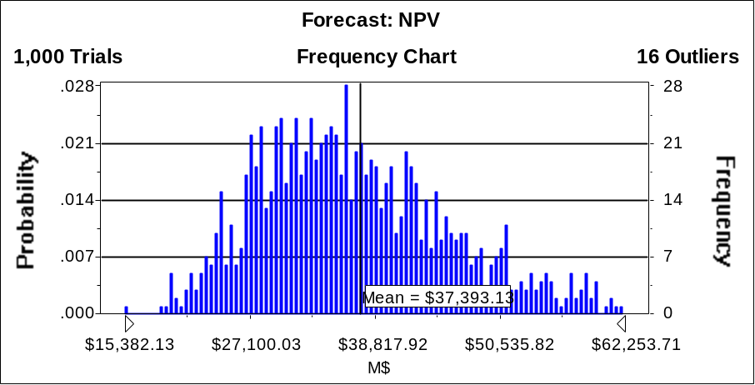
Base Case
TGP = 0.4, OWF = 0.4, DL = 0.8, OHW = 1.
E(NPV) = 37,393 σ =9,501

Slide 51
Deferment Case
Determine participation levels in each project [0,1] AND starting times for each project that
Maximize E(NPV)
While keeping σ < 10,000 M$
All projects may start in year 1, year 2, or year 3. (5x3=15 Decision Variables)
Constraints?
Slide <number>

Slide 52
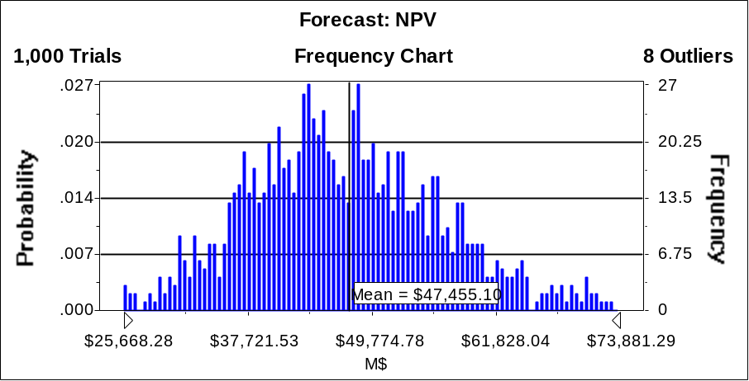
Base Case
Deferment Case
TGP = 0.4, OWF = 0.4, DL = 0.8, OHW = 1.
E(NPV) = 37,393 σ =9,501
TGP₁ = 0.6, DL₁=0.4, OHW₃=0.2
E(NPV) = 47,455 σ =9,513 10th Pc.=36,096

Slide 53
Probability of Success Case
Determine participation levels in each project [0,1] AND starting times for each project that
Maximize P(NPV > 47,455 M$)
While keeping 10th Percentile of NPV > 36,096 M$
All projects may start in year 1, year 2, or year 3.
Slide <number>

Slide 54
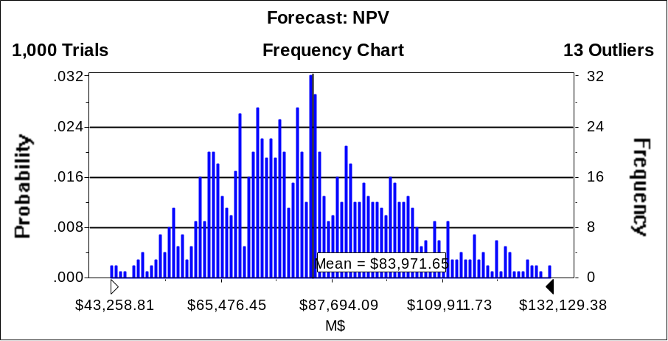
Base Case
Deferment Case
TGP = 0.4, OWF = 0.4, DL = 0.8, OHW = 1.
E(NPV) = 37,393 σ =9,501
TGP₁ = 0.6, DL₁=0.4, OHW₃=0.2
E(NPV) = 47,455 σ =9,513 10th Pc.=36,096
Probability of Success Case
TGP₁ = 1.0, OWF₁=1.0, DL₁=1.0, OHW₃=0.2
E(NPV) = 83,972 σ =18,522 P(NPV > 47,455) = 0.99 10th Pc.=53,359

Slide 55
Benefits
Easy to use
Quickly evaluate many planning alternatives
Optimized financial performance
Better risk control using familiar metrics
Slide <number>

Slide 56
Results for IT Capital Budgeting in a Large Energy Company
Slide <number>

Slide 57
Focusing on IRR
Measure | Ranking | Optimization | Difference
IRR | 33.6% | 43.5% | 29%
Investment | $67M | $53M | 21%
NPV | $22.7M | $23.1M | 2%
Slide <number>

Slide 58
Focusing on NPV
Measure | Ranking | Optimization | Difference
NPV | $18.3M | $23.1M | 26%
Investment | $80M | $53M | 34%
NPV/Inv | 23% | 44% | 89%
Slide <number>

Slide 59
Software Demonstrations
Example 1: Monte Carlo Simulation
    Portfolio of 20 potential projects
    Pharmaceutical product development
      Relatively long and costly R&D
      Probability of Success factor after R&D is complete
    Mutually exclusive (substitute) products
    Dependent (complementary) products
    Choose the best (0,1) set of projects to:
      Maximize return
      Control risk
      Maximize probability of high NPV
Slide <number>

Slide 60
Software Demonstrations
Example 1: Summary Results
      (All cases subject to budget constraint).
  Case 1: Max E[NPV]
  While St.Dev.(NPV) ≤ $ 650
  Result: E[NPV] = $ 2,154
  P(5) = $ 1,103
  St.Dev. = $ 643
Slide <number>

Slide 61
Software Demonstrations
Example 1: Summary Results
      (All cases subject to budget constraint).
  Case 2: Max E[NPV]
  While P(5) ≥ $ 1,103
  Result: E[NPV] = $ 2,346
  P(5) = $ 1,159
  St.Dev. = $ 725
Slide <number>

Slide 62
Software Demonstrations
Example 1: Summary Results
      (All cases subject to budget constraint).
  Case 3: Max P(NPV > $2,154)
  Result: P(NPV > $2,154) = 62%
  E[NPV] = $ 2,346
  P(5) = $ 1,159
  St.Dev. = $ 725
Slide <number>

Slide 63
Software Demonstrations
Example 2: Discrete Event Simulation
    Job Shop Design
    4 workstations and 3 buffer zones for WIP
    Choose the number of machines in each workstation (1,3) and the number of slots in each buffer (1,10) in order to:
      Maximize throughput
      Maximize profit
Slide <number>

Slide 64
Software Demonstrations
Simulation Model:
Manufacturing System
Machine
Buffer position
Exit
Infinite
supply of
blank parts
Buffer 2
Buffer 3
Buffer 4
Work station 1
Work station 2
Work
station 3
Work
station 4
Copyright 2000
Averill Law and Associates
Slide <number>

Slide 65
Software Demonstrations
Problem Setup A
V_{i} (for i = 1, 2, 3, 4) = number of machines in station i
V_{i} (for i = 5, 6, 7) = number of positions in buffer i
n_mach = total number of machines = V₁ + V₂ + V₃ + V₄
n_buff = total number of buffer positions = V₅ + V₆ + V₇
Throughput = total number of parts produced in 30 days
Objective Function (Response): Maximize Profit
Profit = ($200 * Throughput) - ($25,000 * n_mach) - ($1,000 * n_buff)
Bounds for Controls
1 ≤ V_{i} (for i = 1, 2, 3, 4) ≤ 3 1 ≤ V_{i} (for i = 5, 6, 7) ≤ 10
Slide <number>

Slide 66
Software Demonstrations
Problem Setup B
V_{i} (for i = 1, 2, 3, 4) = number of machines in station i
V_{i} (for i = 5, 6, 7) = number of positions in buffer i
n_mach = total number of machines = V₁ + V₂ + V₃ + V₄
n_buff = total number of buffer positions = V₅ + V₆ + V₇
Throughput = total number of parts produced in 30 days
Objective Function (Response): Maximize Throughput
Bounds for Controls
1 ≤ V_{i} (for i = 1, 2, 3, 4) ≤ 3 1 ≤ V_{i} (for i = 5, 6, 7) ≤ 10
Cost Constraint on Controls
25000*(n_mach) + 1000*(n_buff) ≤ 235000
Slide <number>

Slide 67
Conclusions
There is still much to learn and discover about how to optimize simulated systems both from the theoretical and the practical points of view.
The opportunities are exciting!
Slide <number>

Slide 68
Questions & Feedback
Simulation
Optimization
www.OptTek.com
(303) 447-3255
Glover@OptTek.com - Fred
Kelly@OptTek.com - Jim
Slide <number>

